Slide 1
Maindo Parking Website

Slide 2
Website Description
We , at Maindo park attempt to make our customer's life easier by finding them parking spaces at their desired location. Forget about toeing of your cars, parking in no-parking zones and altercations with the traffic police. All you have to do is register into our website and you are all set!
We have recommendations for the best parking position at your desired location. Locating your cars in the parking is much easier with our GPS features.

Slide 3
Hosting link
https://shreyabanerjee.pythonanywhere.com/
Valid Usernames and Password:
unnati , 1234567890
Zenkar , webframeworks
Shreya , webframeworks

Slide 4
Individual Contributions
Shreya B
User login form, handling URL linking
Unnati C
Sign in page for new users, front-end
Zenkar S
User Profile Page, that fetches user info from django database

Slide 5
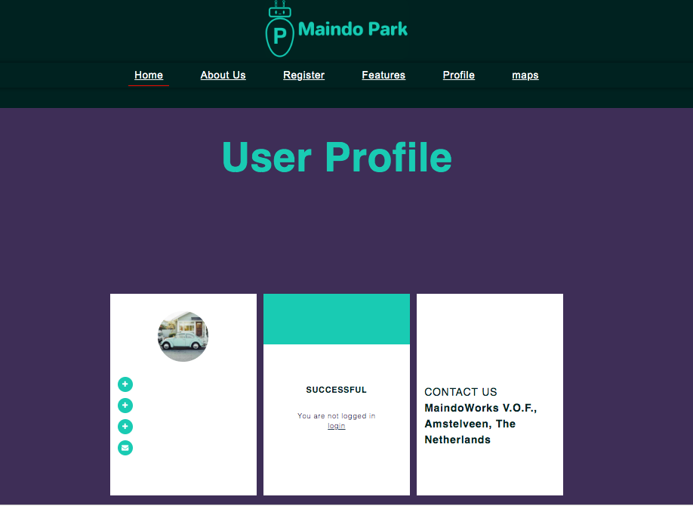
Screen shots

Slide 6
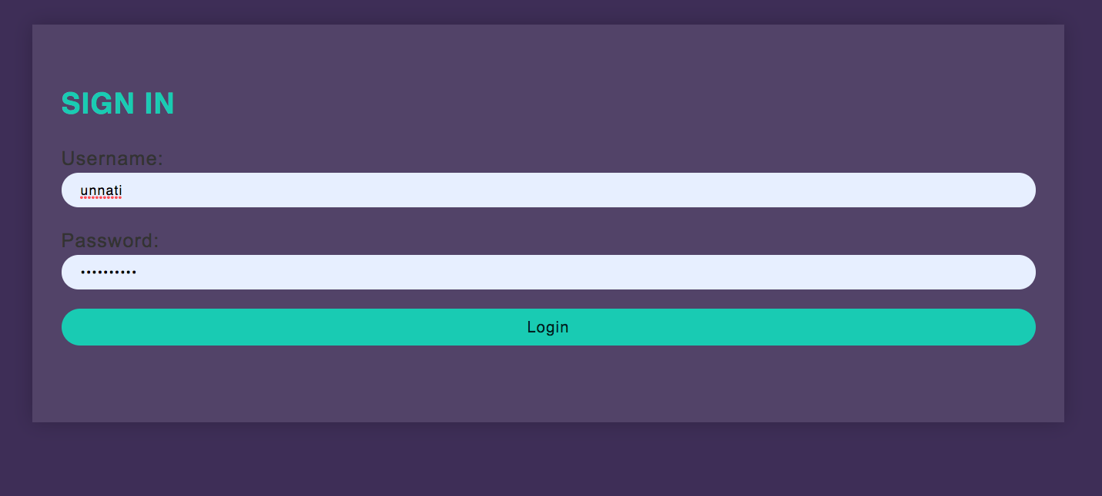
Login form

Slide 7
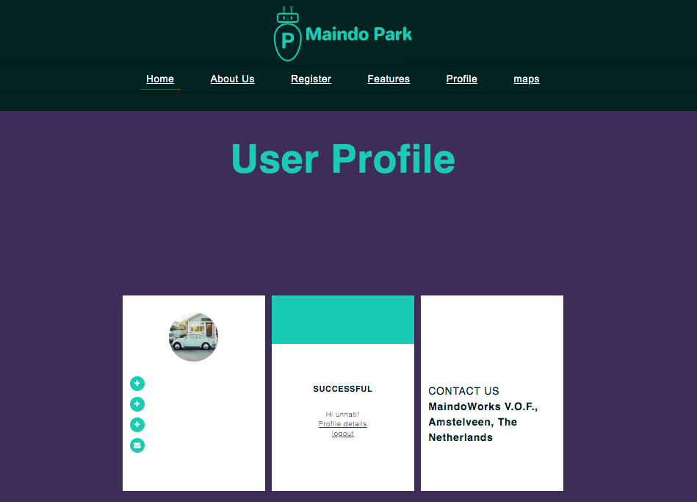

Slide 8
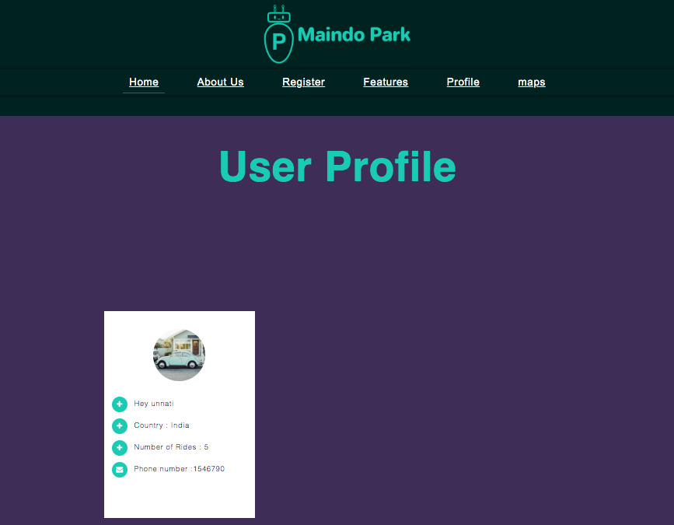
After clicking on Profile Details…

Slide 9
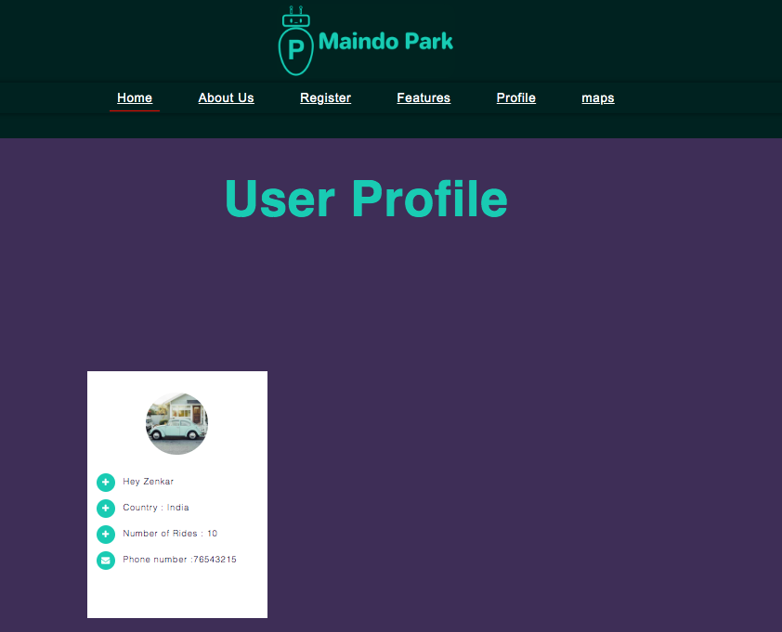
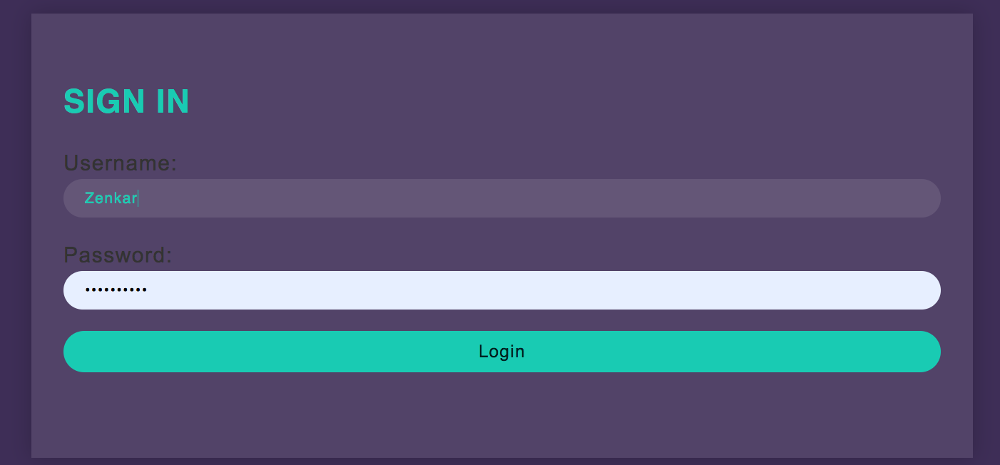
Logged in as another user..

Slide 10
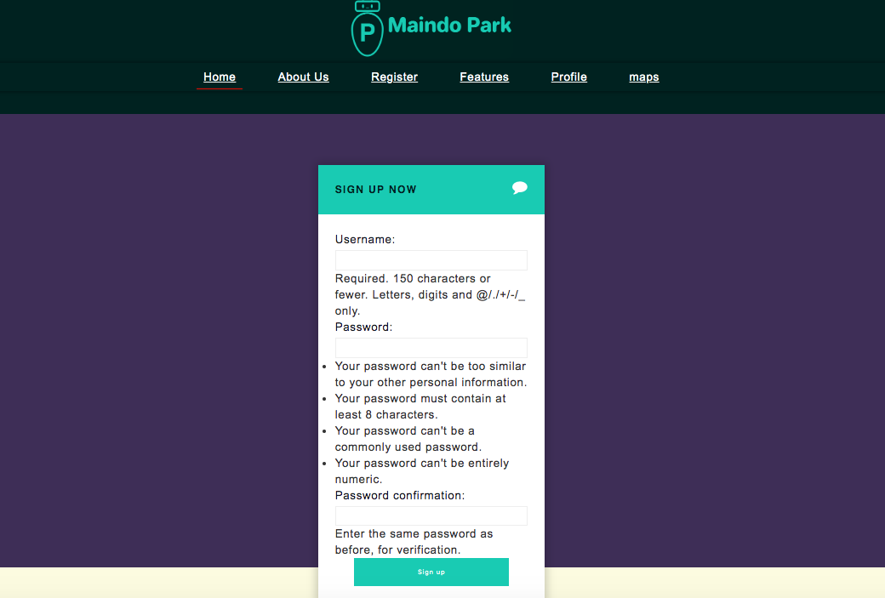
Signup page

Slide 11
Takeaways
User Authentication in Django
Creating new users for website in Django
Fetching the data from django database and displaying
Creating models, templates, loading css for the webpages
Developing a fully functional website on django framework

Slide 12
Challenges
Linking the pages and the urls
Loading static data on the page
Understanding the django framework, collaboration of html and python

Slide 13
Project Team
Shreya Banerjee
PES1201700198
Email : shreyabanerjee167@gmail.com
Unnati Chaturvedi
PES1201700225
Email : unnatichaturvedi295@gmail.com
Zenkar S
PES1201701532
Email : zenkarsrinivas@gmail.com

